Slide 1
Advance Sql
      &
    JDBC

Slide 2
Compiling Topics
Sub-queries and Nested queries.
Queries' optimization.
Stored Procedures and Functions.
Triggers and Cursors.
Introduction to JDBC.
Creating JDBC connection, statements, prepared statements.
Resultsets.
Callable statements.

Slide 3
Sub Queries
Sub Query is query inside another query
A sub query makes it possible to combine two or more queries into a single statement.
Uses the results of one query in the conditional clause of the other.
Place on right side of comparison operator.
Sub queries are usually SELECT statements, and are separated from their parent query by parentheses.
The sub query is executed first.
Sub queries are usually preceded by a conditional WHERE clause, which can contain any of the following comparison and logical operators.
  = values are equal

Slide 4
  <> values are unequal
  <= value on left is less than or equal to value on right
  >= value on left is greater than or equal to value on right
  value on left is less than value on right
  > value on left is greater than value on right
  BETWEEN value on left lies between values on right
  NOT : logical NOT
  AND : logical AND
  OR : logical OR

Slide 5
SYNTAX
( SELECT [DISTINCT] COLUMN Name
FROM {table_name | view_name} ...
[WHERE search_conditions]
[GROUP BY column_name [,column_name ] ...]
[HAVING search_conditions] )

Slide 6
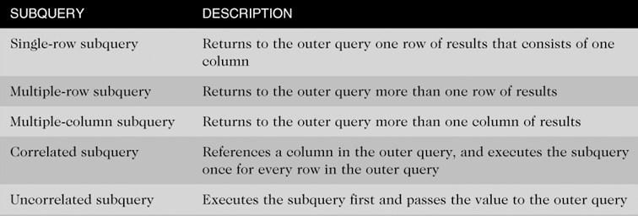
Type Of Sub Queries

Slide 7
Single-Row Subqueries
Can only return one result to the outer query
  Operators include =, >, <, >=, <=, < >
Single Row Using where Clause
SELECT first_name, salary, department_id FROM employees
WHERE salary = (SELECT MIN (salary) FROM employees);
Single Row Using Having
SELECT department_id, MIN (salary) FROM employees Z
GROUP BY department_id HAVING MIN (salary) <
(SELECT AVG (salary) FROM employees)

Slide 8
Multiple Row Sub Query
Multiple-row sub queries are nested queries that can return more than one row of results to the parent query.
Multiple-row sub queries are used most commonly in WHERE and HAVING clauses.
Since it returns multiple rows,it must be handled by set comparison operators (IN, ALL, ANY) .
  ANY and ALL keywords are used with a WHERE or HAVING clause.
  ANY and ALL operate on sub queries that return multiple values.
  ANY returns true if any of the sub query values meet the condition.
  ALL returns true if all of the sub query values meet the condition.

Slide 9
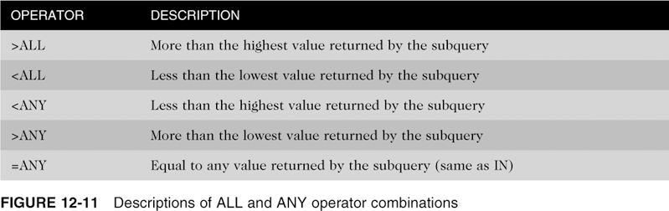
All & ANY Description

Slide 10
Syntax of Any operator
SELECT column-names FROM table-name WHERE column-name operator ANY (SELECT column-name FROM table-name WHERE condition)
Syntax of All operator
SELECT column-names FROM table-name WHERE column-name operator ALL (SELECT column-name FROM table-name WHERE condition)
Example of IN operator :
SELECT first_name, department_id FROM employees WHERE
department_id IN (SELECT department_id FROM departments
WHERE LOCATION_ID = 100)

Slide 11
Example of ANY operator :
Which products were sold by the unit (i.e. quantity = 1)
SELECT ProductName FROM Product WHERE Id = ANY (SELECT ProductId FROM OrderItem WHERE Quantity = 1)
Example of All operator :
List customers who placed orders that are larger than the average of each customer order
SELECT DISTINCT FirstName + ' ' + LastName as CustomerName
FROM Customer, [Order] WHERE Customer.Id = [Order].CustomerId
AND TotalAmount > ALL (SELECT AVG(TotalAmount) FROM
[Order] GROUP BY CustomerId)

Slide 12
Multiple Column Sub Query
Return more than one column in results
Can return more than one row
Column list on the left side of operator must be in parentheses
Use the IN operator for WHERE and HAVING clauses
Example
SELECT * FROM (SELECT salary, department_id FROM employees
WHERE salary BETWEEN 1000 and 2000);

Slide 13
Correlated Sub Query
It is opposite to a regular sub query
In regular sub query the outer query depends on values provided by the inner query.
Whereas a correlated sub query is one where the inner query depends on values provided by the outer query.
This means that in a correlated sub query,the inner query is executed repeatedly, once for each row that might be selected by the outer query.
Example
SELECT EMPLOYEE_ID, salary, department_id FROM employees E WHERE salary > (SELECT AVG(salary) FROM DEPT T WHERE E.department_id = T.department_id)

Slide 14
UnCorrelated Sub Query
Processing sequence:
  Inner query is executed first
  Result is passed to outer query
  Outer query is executed
  Sub Query with Insert Statement
  INSERT INTO table_name [ (column1 , column2 ) ] SELECT [ column1 , column2 ] FROM table1 [table2 ] [ WHERE VALUE OPERATOR ]

Slide 15
Nested Queries
A sub query can be nested inside other sub queries.
SQL has an ability to nest queries within one another.
A sub query is a SELECT statement that is nested within another SELECT statement and which return intermediate results.
Maximum of 255 sub queries if nested in the WHERE clause.
No limit if nested in the FROM clause.
SQL executes innermost sub query first, then next level.
Example
SELECT job_id,AVG(salary) FROM employees GROUP BY job_id HAVING AVG(salary)< SELECT MAX(AVG(min_salary)) FROM jobs WHERE job_id IN (SELECT job_id FROM job_history WHERE department_id BETWEEN 50 AND 100) GROUP BY job_id);

Slide 16
Queries Optimization
Don't use "SELECT * " in a SQL query
  Unnecessary columns may get fetched that will add expense to the data retrieval time.
  hence the query performs slowly.
Avoid unnecessary columns in the SELECT list and unnecessary tables in join conditions
  Selecting unnecessary columns in a Select query adds overhead to the actual query.
  Including unnecessary tables in join conditions forces the database engine to retrieve and fetch unnecessary data and increases the query execution time.

Slide 17
Do not use the COUNT() aggregate in a sub query to do an existence check
  Do not use:
    SELECT column_list FROM table WHERE 0 < (SELECT count(*) FROM table2 WHERE ..)
  Instead, use:
    SELECT column_list FROM table WHERE EXISTS (SELECT * FROM table2 WHERE …)
  When you use COUNT(), SQL Server does not know that you are doing an existence check. It counts all matching values, either by doing a table scan or by scanning the smallest non-clustered index.
  When you use EXISTS, SQL Server knows you are doing an existence check. When it finds the first matching value, it returns TRUE and stops looking. The same applies to using COUNT() instead of IN or ANY.

Slide 18
Try to avoid deadlocks
  Always access tables in the same order in all your Stored Procedures and triggers consistently.
  Keep your transactions as short as possible. Touch as few data as possible during a transaction.
  Never, ever wait for user input in the middle of a transaction.
Try to avoid dynamic SQL
  Unless really required, try to avoid the use of dynamic SQL because:
  Dynamic SQL is hard to debug and troubleshoot.
  If the user provides the input to the dynamic SQL, then there is possibility of SQL injection attacks.

Slide 19
Stored Procedures
A stored procedure contains a sequence of SQL commands stored in the database catalog so that it can be invoked later by a program.
Stored procedures are declared using the following syntax:
Create Procedure <proc-name>(param_1, param_2, …, param_n )
begin
-- execution code
end;
where each param is of the form:
[in | out | inout] <param_name> <param_type>
in mode: allows you to pass values into the procedure,
out mode: allows you to pass value back from procedure to the calling program

Slide 20
Advantage of Stored Procedures
Performance
  Stored procedures are compiled once and stored in executable form, so procedure calls are quick and efficient.
Productivity and Ease of Use
  By designing applications around a common set of stored procedures, you can avoid redundant coding and increase your productivity.
Scalability
  Stored procedures increase scalability by isolating application processing on the server
Maintainability
  Once it is validated, a stored procedure can be used with confidence in any number of applications.

Slide 21
Creating Stored Procedures
Step 1: Change the delimiter (i.e., terminating character) of SQL statement from semicolon (;) to something else (e.g., //)
So that you can distinguish between the semicolon of the SQL statements in the procedure and the terminating character of the procedure definition.
delimiter // or delimiter $$ etc
Step 2: Define a procedure called update Salary which takes as input a department number.
The body of the procedure is an SQL command to update the total salary column of the deptsal table.
Terminate the procedure definition using the delimiter you had defined in step 1 (//)

Slide 22
delimiter //
create procedure updateSalary(IN param1 int)
begin
update deptsal
set totalsalary=(select sum(salary) FROM EMPLOYEE WHERE DNO=PARAM1)
WHERE DNUMBER=PARAM1;
Step 3: Change the delimiter back to semicolon (;)
end; //
Step 4: Call the procedure to update the totalsalary for each department

Slide 23
Use show procedure status to display the list of stored procedures you have created
  > show procedure status
Use drop procedure to remove a stored procedure
  Drop procedure procedure_name
You can use flow control statements (conditional IF-THEN-ELSE or loops such as WHILE and REPEAT)
You can declare variables in stored procedures
  To declare a variable inside a stored procedure, you use the DECLARE statement as follows:
    DECLARE variable_name datatype(size) DEFAULT default_value;
    DECLARE total_sale INT DEFAULT 0;

Slide 24
Function
A function is a routine that could be used in other SQL statements the same way it is possible to use defined MySQL functions like length(), etc.
A function cannot display results.
A function is created using the CREATE command.
The input parameters (IN) are not required in an function. An function must have a RETURN statement and can only return one value.
A function it is called just by using its name.
A function name should be different than existing SQL functions, otherwise you must insert a space between the name and the parenthesis, when defining and calling it.

Slide 25
The information associated to a SF could be seen using the SHOW CREATE FUNCTION command.
The information associated to an SF status could be seen using the SHOW FUNCTION STATUS command.
Syntax:
  function <function-name> (param_spec1, …, param_specn)
  returns <return_type>
  Begin
  -- execution code
  end;
  where param_spec is: [in | osut | in out] <param_name> <param_type>
  You need ADMIN privilege to create functions on mysql-user server

Slide 26
Example
  CREATE OR REPLACE FUNCTION totalCustomers
  RETURN number IS
  total number(2) := 0;
  BEGIN
  SELECT count(*) into total
  FROM customers;
  RETURN total;
  END;
  /

Slide 27
Calling a Function
While creating a function, you give a definition of what the function has to do.
To use a function, you will have to call that function to perform the defined task.
When a program calls a function, program control is transferred to the called function.
A called function performs defined task and when its return statement is executed or when it last end statement is reached, it returns program control back to the main program.
DECLARE
c number(2);
BEGIN
c := totalCustomers();
dbms_output.put_line('Total no. of Customers: ' || c);
END;
/

Slide 28
Predefined Functions
SQL has many built-in functions for performing processing on string or numeric data.
SQL COUNT Function - The SQL COUNT aggregate function is used to count the number of rows in a database table.
SQL MAX Function - The SQL MAX aggregate function allows us to select the highest (maximum) value for a certain column.
SQL MIN Function - The SQL MIN aggregate function allows us to select the lowest (minimum) value for a certain column.
SQL AVG Function - The SQL AVG aggregate function selects the average value for certain table column.
SQL SUM Function - The SQL SUM aggregate function allows selecting the total for a numeric column.

Slide 29
Predefined Functions
SQL SQRT Functions - This is used to generate a square root of a given number.
SQL RAND Function - This is used to generate a random number using SQL command.
SQL CONCAT Function - This is used to concatenate any string inside any SQL command.
SQL Numeric Functions - Complete list of SQL functions required to manipulate numbers in SQL.
SQL String Functions - Complete list of SQL functions required to manipulate strings in SQL
Example.
SELECT MIN(salary) least, MAX(salary) max FROM employee;

Slide 30
Triggers
Triggers are stored programs, which are automatically executed or fired when some events occur. Triggers are, in fact, written to be executed in response to any of the following events:
  A database manipulation (DML) statement (DELETE, INSERT, or UPDATE).
  A database definition (DDL) statement (CREATE, ALTER, or DROP).
  A database operation (SERVERERROR, LOGON, LOGOFF, STARTUP, or SHUTDOWN).
Triggers could be defined on the table, view, schema, or database with which the event is associated.
To monitor a database and take a corrective action when a condition occurs

Slide 31
Triggers
Its parameters depend on the event
It does not return anything
It is not possible to use it with dynamic SQL
OLD and NEW references are not available for table level triggers, rather you can use them for record level triggers.
If you want to query the table in the same trigger, then you should use the AFTER keyword, because triggers can query the table or change it again only after the initial changes are applied and the table is back in a consistent state.
Two commands are associated to a Trigger: CREATE and DROP.
Triggers must have different names than existing SQL functions.

Slide 32
Benefits of Triggers
Triggers can be written for the following purposes:
Generating some derived column values automatically
Enforcing referential integrity
Event logging and storing information on table access
Auditing
Synchronous replication of tables
Imposing security authorizations
Preventing invalid transactions

Slide 33
Syntax of Triggers
CREATE TRIGGER trigger-name
trigger-time trigger-event
ON table-name
FOR EACH ROW
trigger-action;
trigger-time:{BEFORE, AFTER}
trigger-event:{INSERT,DELETE,UPDATE}

Slide 34
Example of Triggers
CREATE OR REPLACE TRIGGER display_salary_changes
BEFORE DELETE OR INSERT OR UPDATE ON customers
FOR EACH ROW
WHEN (NEW.ID > 0)
DECLARE
sal_diff number;
BEGIN
sal_diff := :NEW.salary - :OLD.salary;
dbms_output.put_line('Old salary: ' || :OLD.salary);
dbms_output.put_line('New salary: ' || :NEW.salary);
dbms_output.put_line('Salary difference: ' || sal_diff);
END;
/

Slide 35
Cursors
Cursor is only available from MySQL version 5 or greater.
By using cursor you can get specif records from your database and traverse in every row of the database.
cursor is a kind of loop facility provided in mysql to traverse to every row and manipulate data.
MySQL Cursor his having following 3 properties:
  Asensitive: Means cursor can not create copy of table. In MySQL cursor just traverse on every row of the table or result set.
  Read Only: By help of mysql cursor you can not update any table. But in the loop and row traversal you can take data from cursor and do update But directly from mysql cursor you can not write cursor like declare curs1 cursor for Update test111 set id=2.

Slide 36
  One directional: Mysql Cursor always move in one direction. I mean top to bottom in result set. If you want to traverse in backward direction directly then it is not possible.

Slide 37
Advantage of using Cursors
No need to write business logic after fetching data from your code logic.
Gives you better flexibility for operating even on the single column of the row. Manipulation become always easy.
Saves you from the simplex join structure.
Easy to maintain the business logic of your application at one place.

Slide 38
Disadvantage of using Cursors
Slow down your stored procedure or function performance in cause of large record set in cursor.
Debugging of your business logic become tough.
Hard to manage.
Need to consider locking of the database.

Slide 39
Working with Cursors
Step 1:you have to declare a cursor by using the DECLARE statement:
DECLARE cursor_name CURSOR FOR SELECT_statement;
The cursor declaration must be after any variable declaration.
If you declare a cursor before variables declaration, MySQL will issue an error.
A cursor must always be associated with a SELECT statement.
Step 2: you open the cursor by using the OPEN statement.
The OPEN statement initializes the result set for the cursor, therefore, you must call the OPEN statement before fetching rows from the result set.
OPEN cursor_name;

Slide 40
Step 3:you use the FETCH statement to retrieve the next row pointed by the cursor and move the cursor to the next row in the result set.
FETCH cursor_name INTO variables list;
Step 4: After that, you can check to see if there is any row available before fetching it & can process on that
Step 5: Finally, you call the CLOSE statement to deactivate the cursor and release the memory associated with it as follows:
CLOSE cursor_name;
When the cursor is no longer used, you should close it.

Slide 41
When working with MySQL cursor, you must also declare a NOT FOUND handler to handle the situation when the cursor could not find any row.
Because each time you call the FETCH statement, the cursor attempts to read the next row in the result set.
When the cursor reaches the end of the result set, it will not be able to get the data, and a condition is raised.
The handler is used to handle this condition.
To declare a NOT FOUND handler, you use the following syntax:
DECLARE CONTINUE HANDLER FOR NOT FOUND SET finished = 1;
Where finished is a variable to indicate that the cursor has reached the end of the result set. Notice that the handler declaration must appear after variable and cursor declaration inside the stored procedures

Slide 42
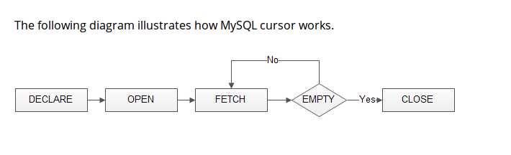
Cursor Flow Diagram

Slide 43
Example of Cursor
DELIMITER $$
CREATE PROCEDURE build_email_list (INOUT email_list varchar(4000))
BEGIN
DECLARE v_finished INTEGER DEFAULT 0;
DECLARE v_email varchar(100) DEFAULT "";
-- declare cursor for employee email
DEClARE email_cursor CURSOR FOR
SELECT email FROM employees;
-- declare NOT FOUND handler
DECLARE CONTINUE HANDLER FOR NOT FOUND SET v_finished = 1;

Slide 44
Example of Cursor contd.
OPEN email_cursor;
get_email: LOOP
FETCH email_cursor INTO v_email;
IF v_finished = 1 THEN
LEAVE get_email;
END IF;
-- build email list
SET email_list = CONCAT(v_email,";",email_list);
END LOOP get_email;
CLOSE email_cursor;
END$$
DELIMITER ;

Slide 45
Introduction to JDBC
JDBC (Java Database Connectivity) API allows Java programs to connect to databases.
Database access is the same for all database vendors.
The JVM uses a JDBC driver to translate generalized JDBC calls into vendor specific database calls.
There are four general types of JDBC drivers
  Type 1: JDBC-ODBC Bridge
  Type 2:Native API, partially Java
  Type 3:JDBC Network Driver, partially Java
  Type 4:100% Java

Slide 46

Type 4
Converts JDBC directly to native API used by the RDBMS.
compiles into the application , applet or servlet doesn’t require anything to be installed on client machine, except JVM.
handiest driver type

Slide 47
Creating JDBC
There are 5 steps to connect any java application with the database in java using JDBC. They are as follows:
  Register the driver class
  Creating connection
  Creating statement
  Executing queries
  Closing connection

Slide 48
Register the driver class
  The forName() method of Class class is used to register the driver class. This method is used to dynamically load the driver class.
Syntax of forName() method
public static void forName(String className)throws ClassNotFoundException
Example to register the OracleDriver class
Class.forName("com.mysql.jdbc.Driver");

Slide 49
Create the connection object
  The getConnection() method of DriverManager class is used to establish connection with the database.
Syntax of getConnection() method
1) public static Connection getConnection(String url)throws SQLException
2) public static Connection getConnection(String url,String name,String password)
throws SQLException
Example
Connection con=DriverManager.getConnection("jdbc:mysql://localhost/", "username", "password");

Slide 50
Create the Statement object
  The createStatement() method of Connection interface is used to create statement. The object of statement is responsible to execute queries with the database.
Syntax of createStatement() method
public Statement createStatement()throws SQLException throws SQLException
Example
Statement stmt=con.createStatement();

Slide 51
Execute the query
  The executeQuery() method of Statement interface is used to execute queries to the database. This method returns the object of ResultSet that can be used to get all the records of a table.
Syntax of executeQuery() method
public ResultSet executeQuery(String sql)throws SQLException
Example
ResultSet rs=stmt.executeQuery("select * from emp");
while(rs.next()){
System.out.println(rs.getInt(1)+" "+rs.getString(2));
}

Slide 52
Close the connection object
  By closing connection object statement and Result Set will be closed automatically. The close() method of Connection interface is used to close the connection.
Syntax of close() method
public void close()throws SQLException
Example
con.close();

Slide 53
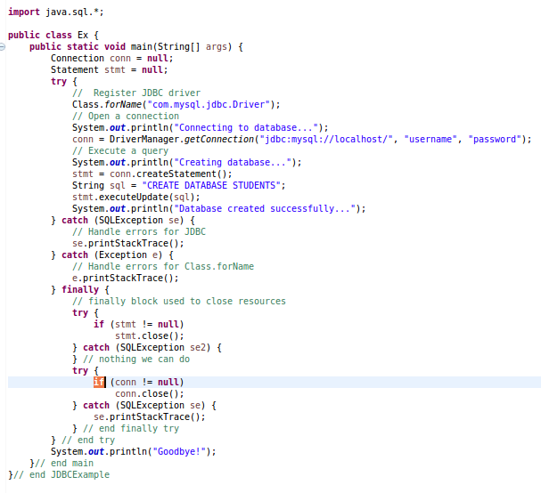

Slide 54
Statement
The Statement interface provides methods to execute queries with the database. The statement interface is a factory of Result Set i.e. it provides factory method to get the object of Result Set.
Commonly used methods of Statement interface:
  public ResultSet executeQuery(String sql): is used to execute SELECT query. It returns the object of ResultSet.
  public int executeUpdate(String sql): is used to execute specified query, it may be create, drop, insert, update, delete etc.
  public boolean execute(String sql): is used to execute queries that may return multiple results.
  public int[] executeBatch(): is used to execute batch of commands.

Slide 55
Prepared Statement
The Prepared Statement interface is a sub interface of Statement. It is used to execute parameterized query.
we will pass parameter (?) for the values. Its value will be set by calling the setter methods of Prepared Statement
Why use Prepared Statement?
Improves performance: The performance of the application will be faster if you use Prepared Statement interface because query is compiled only once.
Example
String sql="insert into emp values(?,?,?)";

Slide 56
How to get the instance of PreparedStatement?
The prepareStatement() method of Connection interface is used to return the object of PreparedStatement. Syntax:
public PreparedStatement prepareStatement(String query)throws SQLException{}

Slide 57
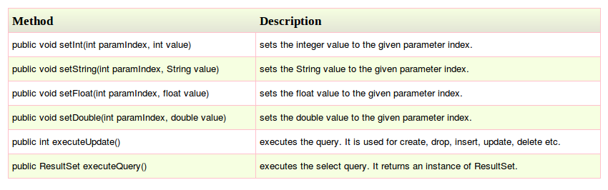
Method of PreparedStatement

Slide 58
Example of PreparedStatement contd.
import java.sql.*;
class InsertPrepared{
public static void main(String args[]){
try{
Class.forName("oracle.jdbc.driver.OracleDriver");
Connection con=DriverManager.getConnection("jdbc:oracle:thin:@localhost:1521:xe","system","oracle");

Slide 59
Example of PreparedStatement
PreparedStatement stmt=con.prepareStatement("insert into Emp values(?,?)");
stmt.setInt(1,101);//1 specifies the first parameter in the query
stmt.setString(2,"Ratan");
int i=stmt.executeUpdate();
System.out.println(i+" records inserted");
con.close();
}catch(Exception e){ System.out.println(e);}
}
}

Slide 60
ResultSet
The object of Result Set maintains a cursor pointing to a particular row of data. Initially, cursor points to before the first row.
But we can make this object to move forward and backward direction by passing either TYPE_SCROLL_INSENSITIVE or TYPE_SCROLL_SENSITIVE in createStatement(int,int) method as well as we can make this object as updatable by:
Statement stmt = con.createStatement(ResultSet.TYPE_SCROLL_INSENSITIVE,
ResultSet.CONCUR_UPDATABLE);

Slide 61
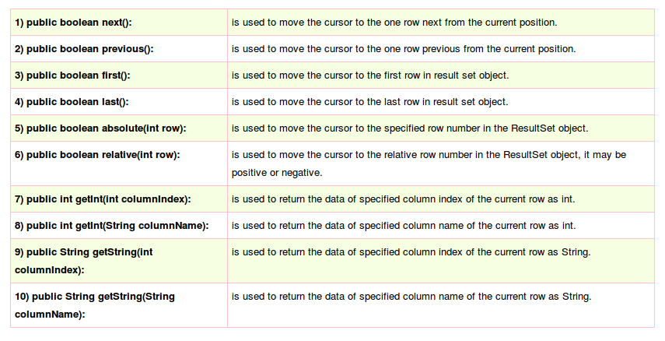
Methods of ResultSet

Slide 62
Example of ResultSet
Class.forName("oracle.jdbc.driver.OracleDriver");
Connectioncon= DriverManager.getConnection("jdbc:oracle:thin:@localhost:1521:xe", "system","oracle");
Statement stmt=con.createStatement(ResultSet.TYPE_SCROLL_SENSITIVE,ResultSet.CONCUR_UPDATABLE);
ResultSet rs=stmt.executeQuery("select * from emp765");

Slide 63
Example of ResultSet
//getting the record of 3rd row
rs.absolute(3);
System.out.println(rs.getString(1)+" "+rs.getString(2)+" "+rs.getString(3));
con.close();

Slide 64
Callable Statement
To call the stored procedures and functions, Callable Statement interface is used.
We can have business logic on the database by the use of stored procedures and functions that will make the performance better because these are p recompiled
How to get the instance of Callable Statement?
The prepareCall() method of Connection interface returns the instance of Callable Statement Syntax is given below:
public CallableStatement prepareCall("{ call procedurename(?,?...?)}");
Example
CallableStatement stmt=con.prepareCall("{call myprocedure(?,?)}");

Slide 65
Example of Callable Statement
import java.sql.*;
public class Proc {
public static void main(String[] args) throws Exception{
Class.forName("oracle.jdbc.driver.OracleDriver");
Connectioncon=DriverManager.getConnection("jdbc:mysql://localhost/", "username", "password");
CallableStatement stmt=con.prepareCall("{call insertR(?,?)}");
stmt.setInt(1,1011);
stmt.setString(2,"Amit");
stmt.execute();
System.out.println("success");
}
}

Slide 66
Question's ?

Slide 67
Thank You :)

